Slide 1
Health Care Analysis
Name: Velcy Jadawala
Subject: Tableau

Slide 2
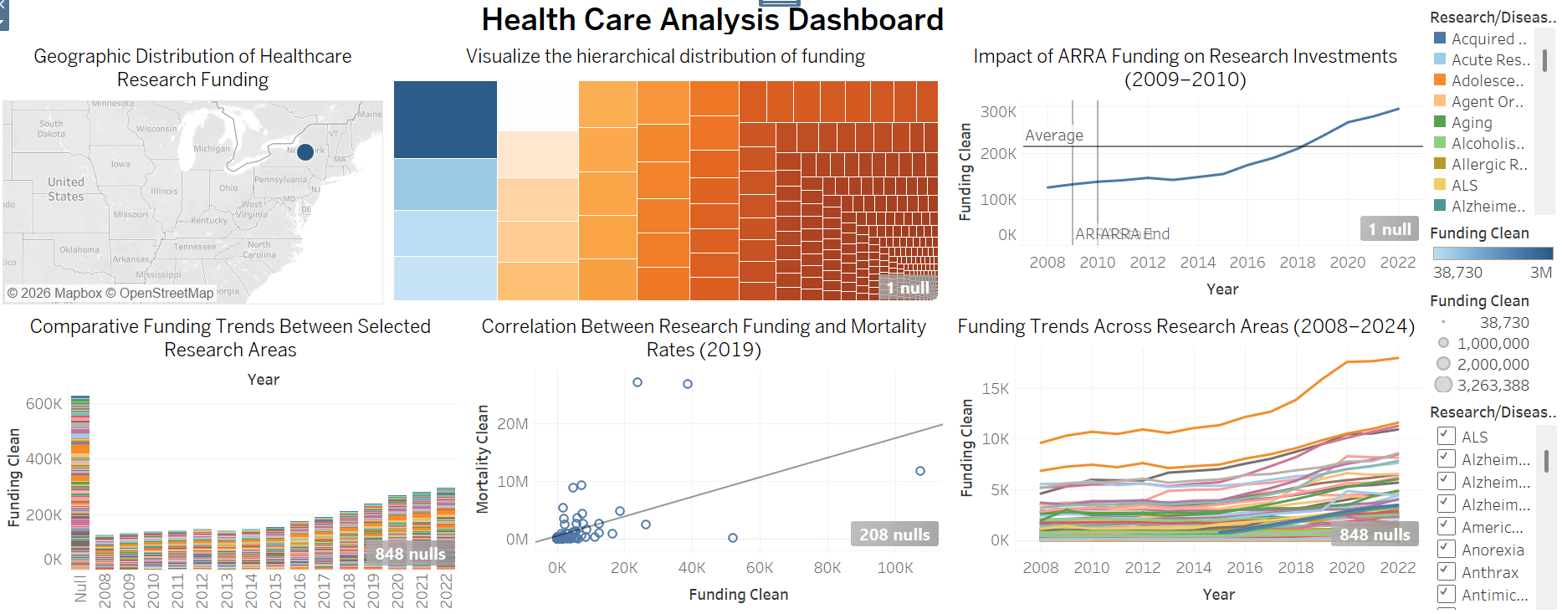

Slide 3
